Slide 1

IMPACT COLLEGE OF ENGINEERING SAHAKARANAGAR SOUTH,BENGALURU-560092
DEPARTMENT OF COMPUTER SCIENCE AND ENGINEERING
Project Phase 2 Presentation on
TITLE : Attendance system using face detection and recognition
Presented By:
TEJASVI JB (1IC16CS042)
THANUSHREE JB (1IC16CS043)
Under the Guidance Of:
Prof. Hemavathi J
Dept. of CSE,ICEAS

Slide 2
Contents
Abstract
Introduction
Scope
Literature survey
Problem Definition
System Architecture
Haar cascade algorithm
Database Diagram
Detection rate
Advantages
Future work
References
2

Slide 3
Abstract
Attendance Management System with the help of Face detection
Better than traditional method
Easy to maintain and saves time
Record is maintained

Slide 4
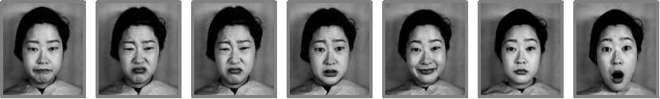
Introduction
Face Recognition is a biometric method of identifying an individual by comparing live capture or digital image data with the stored record for that person.
Face Recognition Attendance System is marking of attendance based on this technology.

Slide 5
Scope
Automated attendance system that is practical, reliable
Eliminate disturbance,time loss of traditional attendance systems.
Evaluate students performance depending on their recorded attendance rate.
Avoid indirect contact present in fingerprint authentication
5

Slide 6
Literature Survey
Sr. No | Author | Title | Published in | Description
1 | Adrian Rhesa Septian Siswanto, Anto Satriyo Nugroho, Maulahikmah Galinium | Implementation of face recognition algorithm for biometrics based time attendance system | IEEE, ICT For Smart Society (ICISS), International Conference ,January 2015 | To get the best facial recognition algorithm (Eigenface and Fisherface) provided by the Open CV 2.4.8 by comparing the ROC (Receiver Operating Characteristics) curve and implement it in the attendance system as the main case study
2. | Nirmalya Kar, Mrinal Kanti Debbarma, Ashim Saha, and Dwijen Rudra Pal | Study of Implementing Automated Attendance System | International Journal of Computer and Communication Engineering, Vol. 1, No. 2, July 2012 | This paper describes how to take student's attendance using face recognition. The face recognition is implemented with the help of Principal Component
3. | V. Shehu and A. Dika | Using Face Recognition Technique Using Real Time Computer Algorithms in Automatic Attendance Management Systems | IEEE, pp. 397 – 402, Jun. 2010 | This paper introduces a new approach in automatic attendance management systems, extended with computer vision algorithms. We propose using real time face detection algorithms integrated on an existing Learning Management System

Slide 7
Problem Definition
Traditionally, student’s attendance system consumes more time
It is very difficult to verify one by one student in a large practical lab with distributed branches whether the authenticated students are actually responding or not.

Slide 8
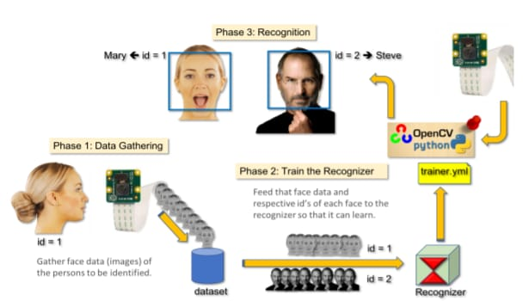
PHASES
Phase1: Gathering
Phase2: Train the recognizer
Phase3: Recognition

Slide 9
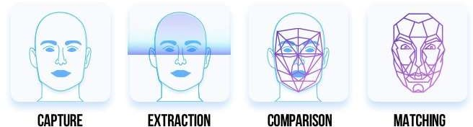
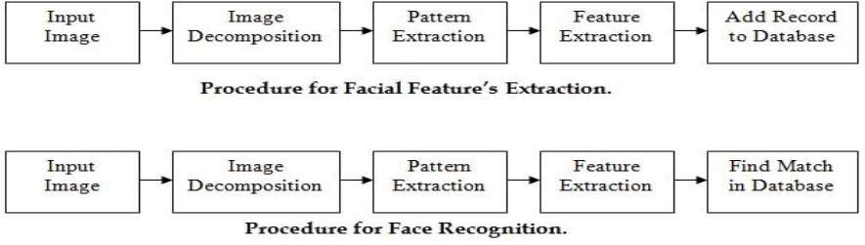
How it works?

Slide 10
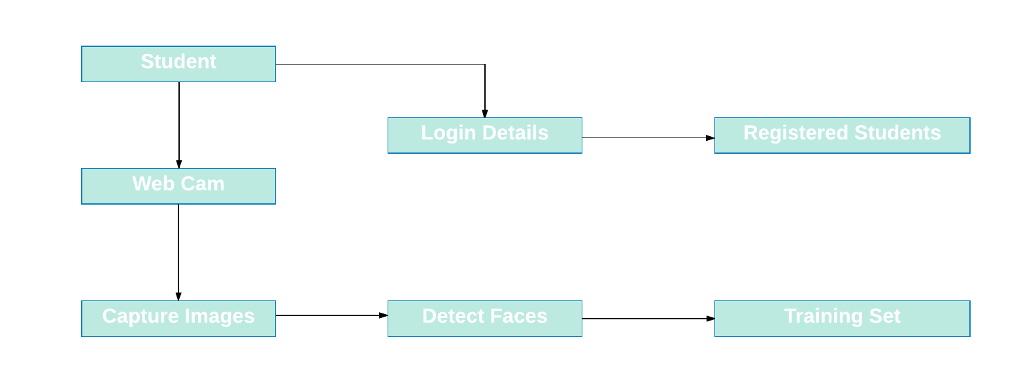
System architecture
Training : Registration

Slide 11
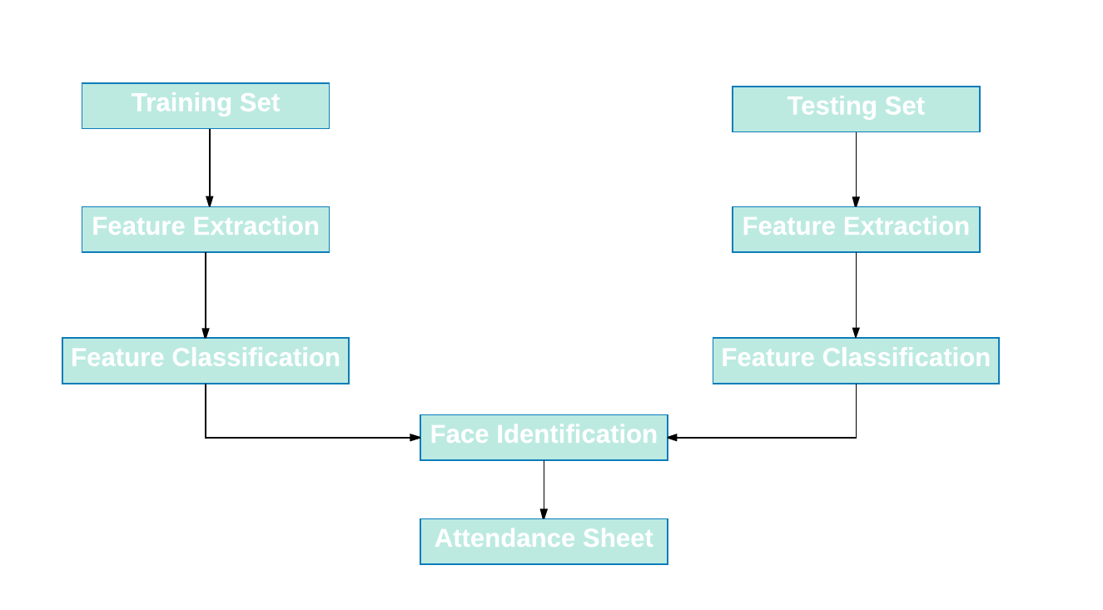
System architecture
Recognition Phase

Slide 12
System architecture
Testing Phase : Attendance
Capture Image
Mark Attendance
Detect Image
Recognize Image

Slide 13
Why OpenCV?
Focus on real-time image processing
Written in C/C++
C/C++ interface – Also in Python, Java, Matlab/Octave
Cross-platform – Windows, Mac, Linux, Android, iOS, etc
Use CMake
Open source and free!

Slide 14
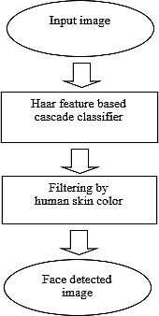
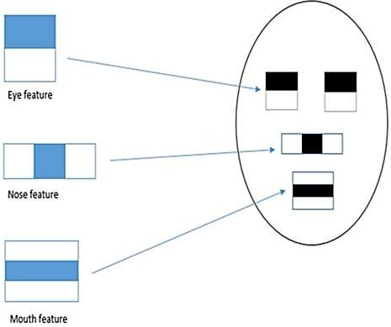
Face Detection by Haar Cascade
Haar cascades are machine learning object detection algorithms.
They use use Haar features to determine the likelihood of a certain point being part of an object.

Slide 15
Demonstration of face detection
Features are applied on the images in stages
The second stage processing would start, only when the features in the first stage are detected in the image.
Fig. The GIF shows how a haar feature traverses on an image from its left towards its right.
Fig. Feature Detection on an Image containing a face

Slide 16
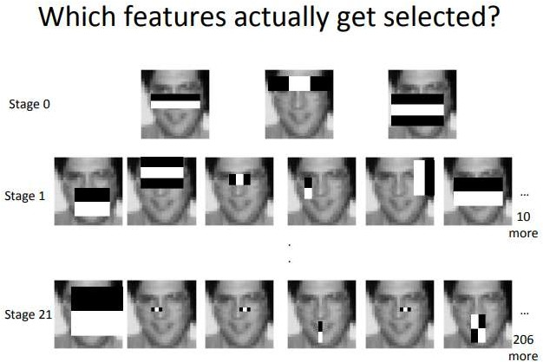
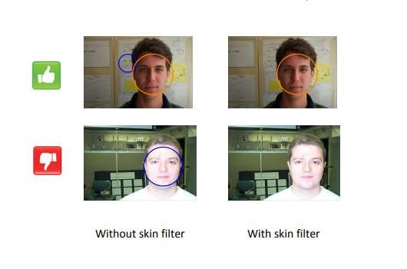
Face Detection by Haar Cascade(cont…)

Slide 17
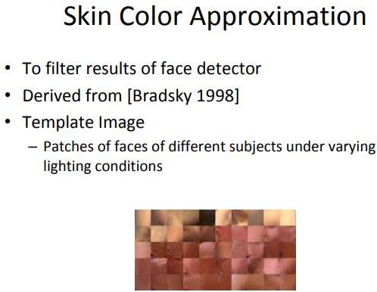
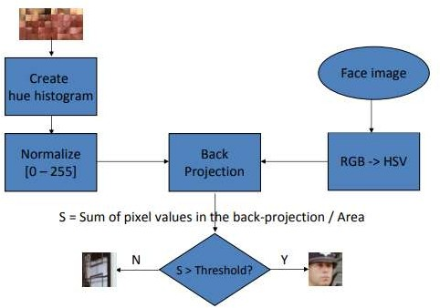
Face Detection by Haar Cascade(cont…)

Slide 18
Database Dictionary
Field Name | Data Type | Length | Constraint | Description
Roll_no | Int | 3 | Primary key | Student roll no
Name | Varchar | 20 | Not null | Name of student
Date | Date | 10 | Not null | Date of the attendance
Time | Time | 10 | Not null | Time of the attendance
Class | Varchar | 20 | Not null | Class of student
Subject | Varchar | 20 | Not null | Subject of student
Images | .pgm | 100 | Size must be of 11KB | Images of students

Slide 19
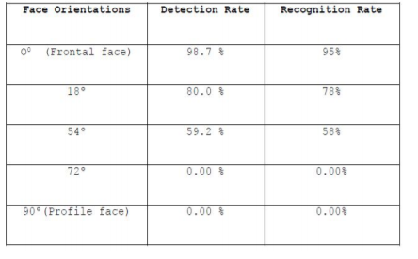
Detection rate
Table 1: Detection and Recognition rate concerning face orientation
Different images of 5 persons are used in the training set.
The evaluation showed that the recognition part can achieve approximately 70-80% recognition rate based on the image resolution.

Slide 20

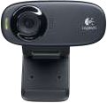

Platform
Python
Tkinter
OpenCV
Usb Camera (8MP)
SQLyog Community MySQL GUI v.8.55

Slide 21

Advantages
Proxy attendance is eliminated
It saves there time and efforts.
It stores the faces that are detected and automatically marks attendance.
The system is convenient and secure for the user.

Slide 22

Limitations
It can only detect face from a limited distance with some specific angle
The system don’t recognized properly in poor light so may give false results.
Cannot distinguish real human face and a human face present in the photo

Slide 23
Future work
Can improve security by adding administrator login.
Can use Neural Network for high accuracy.
Can build on a fully web-based system.
Mark attendance only if the student is wearing mask
Improve Face detection in low light conditions

Slide 24
Conclusion
In our proposed system does not require to carry any hardware device nor to perform some kind of direct biometric identification.
The proposed system an easy way for marking attendance where student is identified by camera, where the faces are matched to the one stored in the database after comparing the trained images.

Slide 25

References
[1]. Adrian Rhesa Septian Siswanto, Anto Satriyo Nugroho, Maulahikmah Galinium,” Implementation of face recognition algorithm for biometrics based time attendance system”, IEEE, ICT For Smart Society (ICISS), International Conference ,January 2015.
[2]. International Journal of Computer and Communication Engineering, Vol. 1, No. 2, July 2012 - Study of Implementing Automated Attendance System Using Face Recognition Technique by Nirmalya Kar, Mrinal Kanti Debbarma, Ashim Saha, and Dwijen Rudra Pal.
[3]. Real time face recognition system using PCA and various distance classifiers byDeepesh Raj – IIT Kanpur.

Slide 26
THANK YOU

